Slide 1
Learning from Data
6th Sep 2019

Slide 2
Recap
PAC Learning
Hoeffding’s Inequality
Where M = Growth Function

Slide 3
Important Notions
Dichotomies :
Growth Function :
Notion of “Shattering the Data”
VC Dimension :
Learnability :

Slide 4
Expressive-ness in Hypothesis class
Arrange in order of expressive-ness “h1” , “h2”
h1
h2
Hypothesis h2 can handle more variations in data configurations compared to h1
Can be seen as : Count of number of variations that a hypothesis class can handle

Slide 5
Simple Hypothesis (Linear)
Constellation of 14 points that are separable
Constellation of 14 points that are Not separable

Slide 6
Complex Hypothesis (Quadratic)
Constellation of 14 points that are separable
Constellation of 14 points that are still separable

Slide 7
Simple Vs Complex Hypothesis
Given a fixed number of Data points “N” :
A simple hypothesis can handle a limited number of Data configurations
A complex hypothesis can handle greater number of Data configurations
Why ??

Slide 8
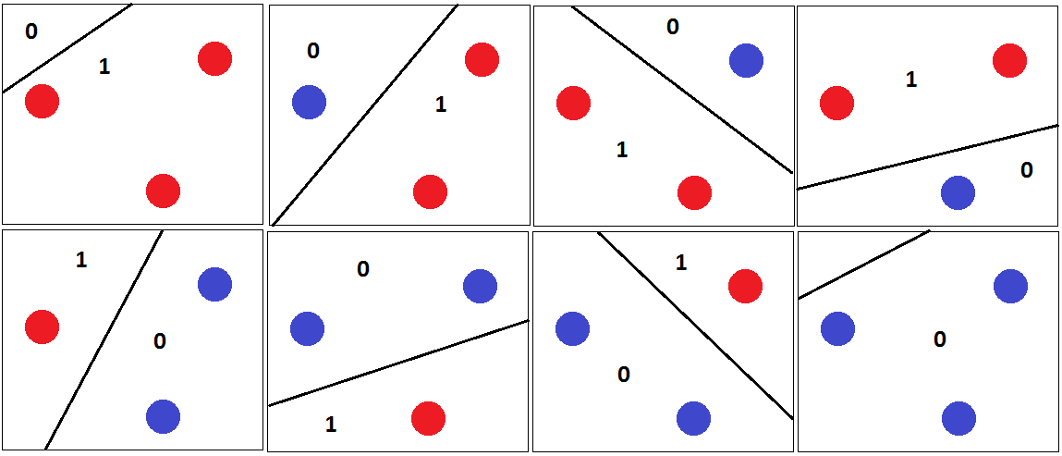
Recall : Shattering a Data set
The Hypothesis class is maximally expressive for a given ‘N” if it is able to handle ALL possible Data Configurations - Shattering the Data Set
The Value of “N”, Number of Data points for which the Hypothesis can shatter the Data Set is a very special Number, called VC Dimension

Slide 9
Why is VC Dimension impt ?
VC Dimension dictates Learnability
How well is the Concept Learnt, How many Training Samples are sufficient ?
Depends on the VC Dimension of the Hypothesis class
Eg. To learn a Linear Separator, we would need far fewer samples than to learn a
5th Degree Polynomial Separator

Slide 10
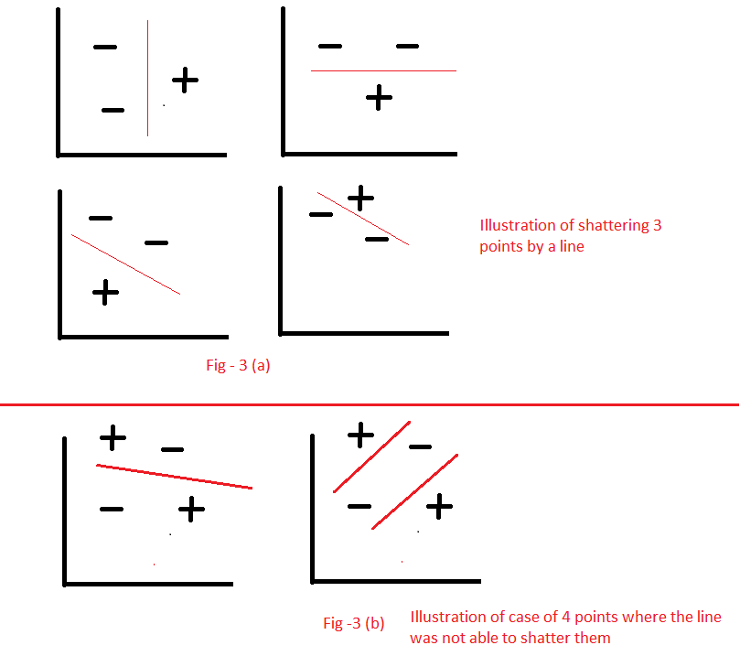
Impact of “N” : 2D Linear Separator
For N = 4, Shattering is NOT Possible
For N = 3, Shattering is Possible
Hence, for 2D Linear Class , VC Dimension = 3

Slide 11
Growth Function
Growth Function is defined for a Hypothesis Class
Growth Function is a function of “N”
M_{H}(N) is used to denote the Growth function
M_{H}(N) is the Maximum number of Dichotmies on “N” points
The N points can be placed in whichever way
The Maximum value that M_{H}(N) can take is 2^{N}

Slide 12
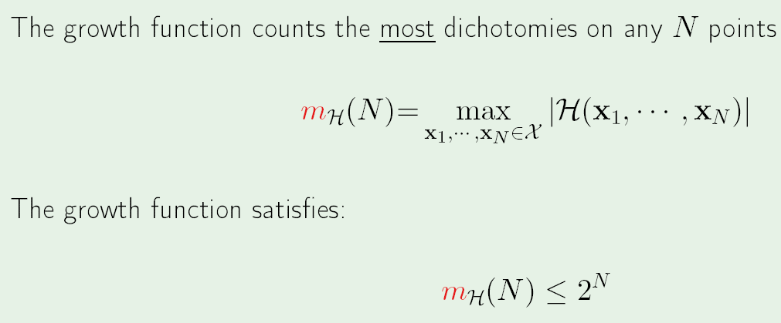
Growth Function

Slide 13
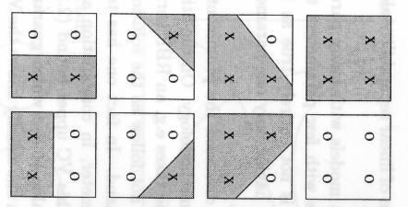
Recall : Dichotomy
Separators leading to Distinct ways of partitioning the Data Points
As many Distinct ways of partitioning the Data points, that many Dichotomies
Growth Function counts the Maximum number of possible Dichotomies, for fixed N

Slide 14
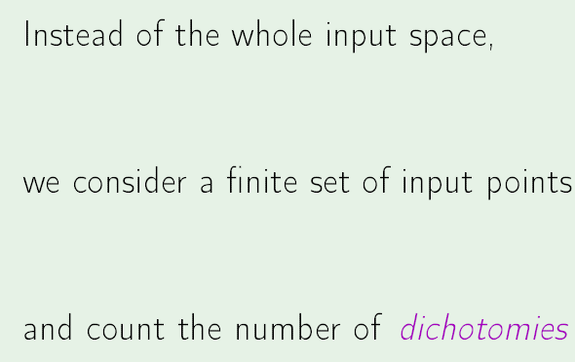
Hypothesis - Dichotomies

Slide 15
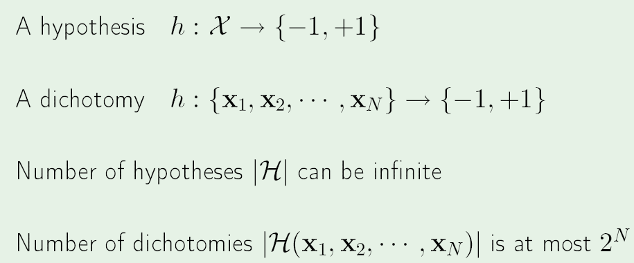
Hypothesis - Dichotomies

Slide 16
Break Point
The number “k”, of data points, for which NOT all possible classifications can be achieved
N = 4 is a Break point for a 2D Linear Separator

Slide 17
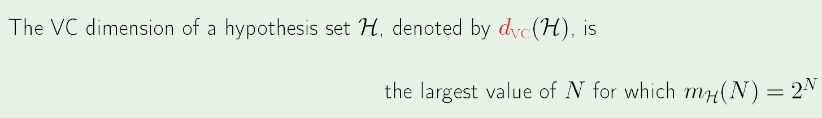
VC Dimension
Expressive power of the Hypothesis
The VC dimension of a class H is the largest “N”, such that the value of Growth function = 2^{N}
Break_point = VC_dimension + 1 (These measures are, Specific to a Hypothesis Set)
For a Linear Classifier in “d” dimensions : VC_Dim = d + 1

Slide 18
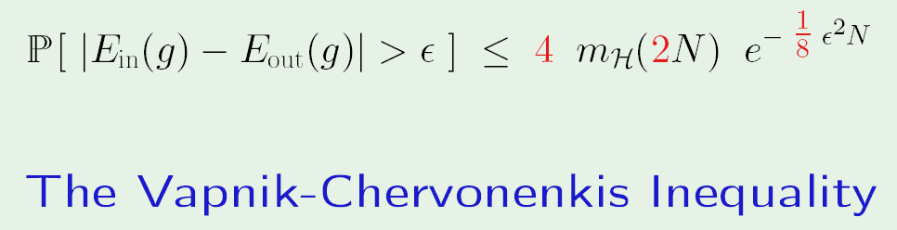
Hoeffding to VC Inequality
m_{H}(U) = Polynomial in U, if VC_Dim = Finite Quantity
Hence, Finite value for VC_Dim implies PAC Learning possible

Slide 19
When Is Learning Not possible ?
Think of a Hypothesis class, where Learning is not possible…..

Slide 21
Learnt Vs. Target function

Slide 22
2 aspects of Learning
Behaviour on Training Data should resemble behaviour on Test Data –
Also called Generalization

Slide 23
Approximation Vs Generalization
The goal is to learn the hypothesis g(x) which behaves like the unknown target function “f” such that :
[g(x) – f(x)] is very small, for all possible values of input set
Although g(x) is learnt using only training samples

Slide 24
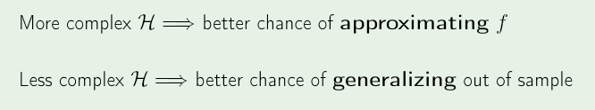
2 aspects of Learning
Error on Test Data should be Small – Also called Approximation
We want : Small E_{out} => Good approximation of “f” not only on training data set, but also on test data

Slide 25
Approximation Vs Generalization

Slide 26
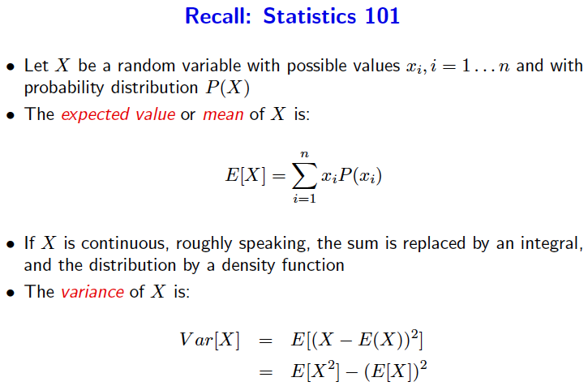
Recap : Stats

Slide 27
Estimator Performance
For an Estimator, Over the population x, if the parameter being estimated is, say “Ɵ”; and the Estimator estimates Ө̂ then
Error, e is defined as :
e(x) = Ө̂ (x) - Ɵ
MSE , Popular performance measure
MSE = Mean([Ө̂(x) - Ɵ]²) = E _{x} ([Ө̂(x) - Ɵ]²)
MSE can always be decomposed into

Slide 28
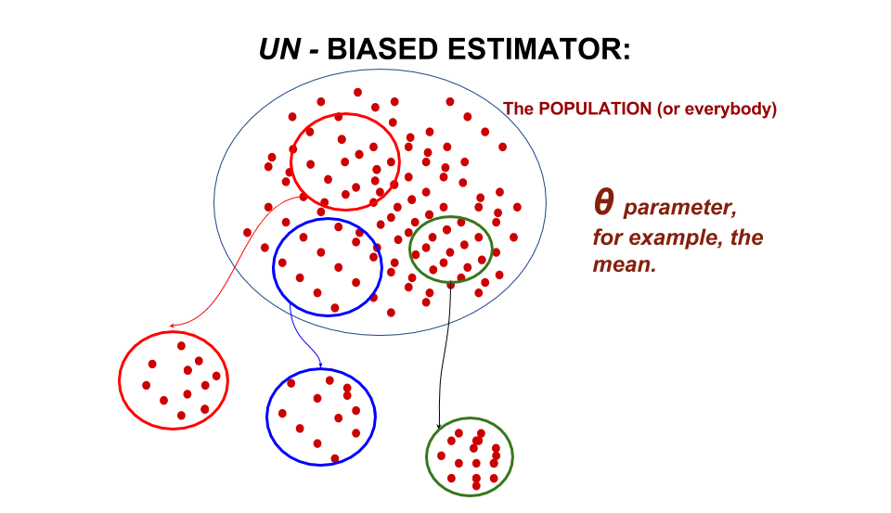
Estimator Attributes - Bias
Bias : English - Prejudice; inclination one way or the other
Bias = Deviation of the true parameter value from Expected value of the estimate
B(Ө̂ ) = E [Ө̂ ] - Ɵ
Bias can also be interpreted as the expected value of the error. Why ??
What is desired in an estimator ?

Slide 29
Estimator Attributes - Variance
Variance : English : Spread in values
Variance (Ө̂ ) = Expected value of squared sampling deviations
Variance (Ө̂ ) = E[(Ө̂̂ - E[Ө̂ ])²]
Indicates how far, on average, the collection of estimates are from the expected value of the estimates
What is desired value of variance in an estimator ?

Slide 30
Estimator Attributes
Desirable properties of estimators are :
Minimal bias and Minimal Variance

Slide 31
Bias-Variance Analysis
Decomposes E_{out} into 2 components :
How good is the Hypothesis set H, in approximating the target function (Bias)

Slide 32
For a chosen hypothesis function “g”, learnt using given training Data D,
Let’s call the resulting E_{out} as : E_{out}(g^{D})
What is E_{out}(g^{D}) ?
It is the quantity, [g^{D} (x) – f(x)]² for all possible values of x
^{i.e} [g^{D} (x) – f(x)]² averaged over all x
Or E_{out}(g^{D}) = E_{x}[g^{D} (x) – f(x)]²
E_{out}(g^{D}) has to cover all possible training Data sets D
Hence average over all possible “D” : Evaluate E_{D}[E_{out}(g^{D})]

Slide 33
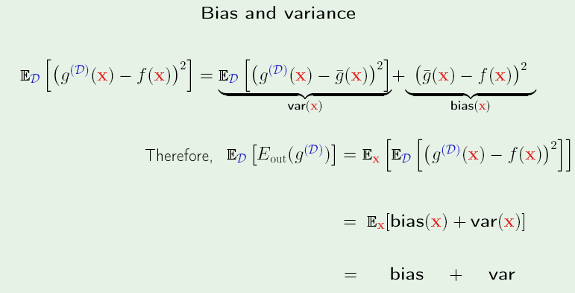
Bias - Variance

Slide 34
Bias - Variance

Slide 35
Simple Vs Complex H
When Hypothesis space is simple, the number of available Hypotheses to choose from is small
The variance is small but bias is large
As Hypothesis space becomes more complex, the number of available Hypotheses to choose from increases

Slide 36
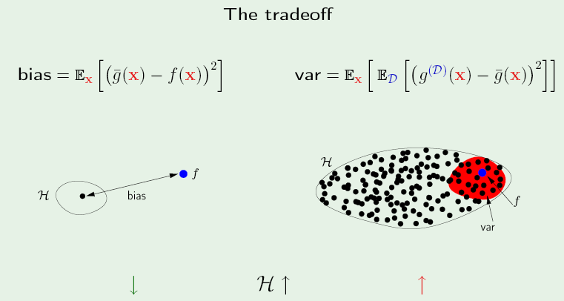
Illustration - Tradeoff
Simple Hypothesis
Complex Hypothesis
What do we infer ..???

Slide 37
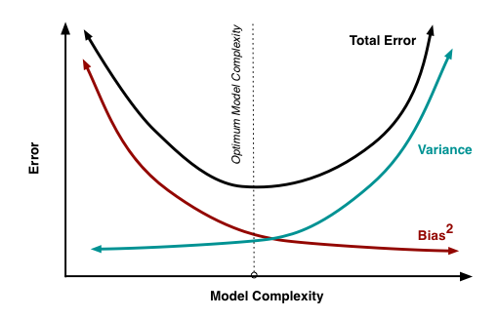
Bias-Variance-Model Complexity

